Slide 1

GMOS RUN4
USER MANUAL

Slide 2
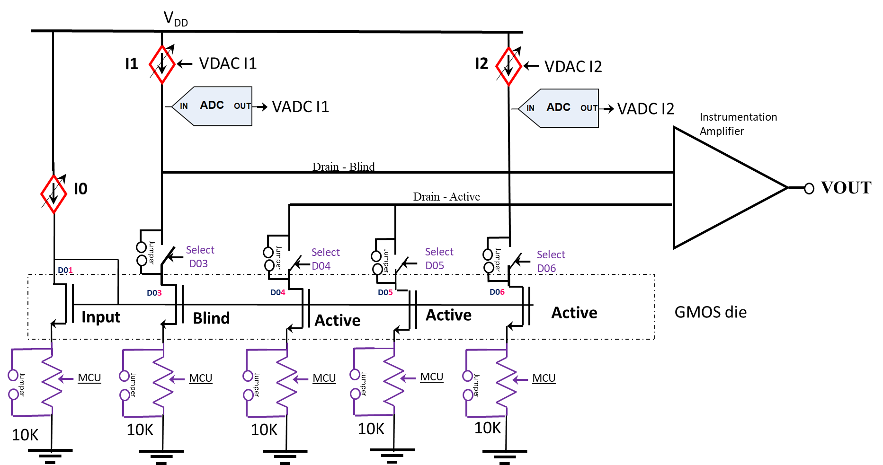
Scheme – Block diagram

Slide 3
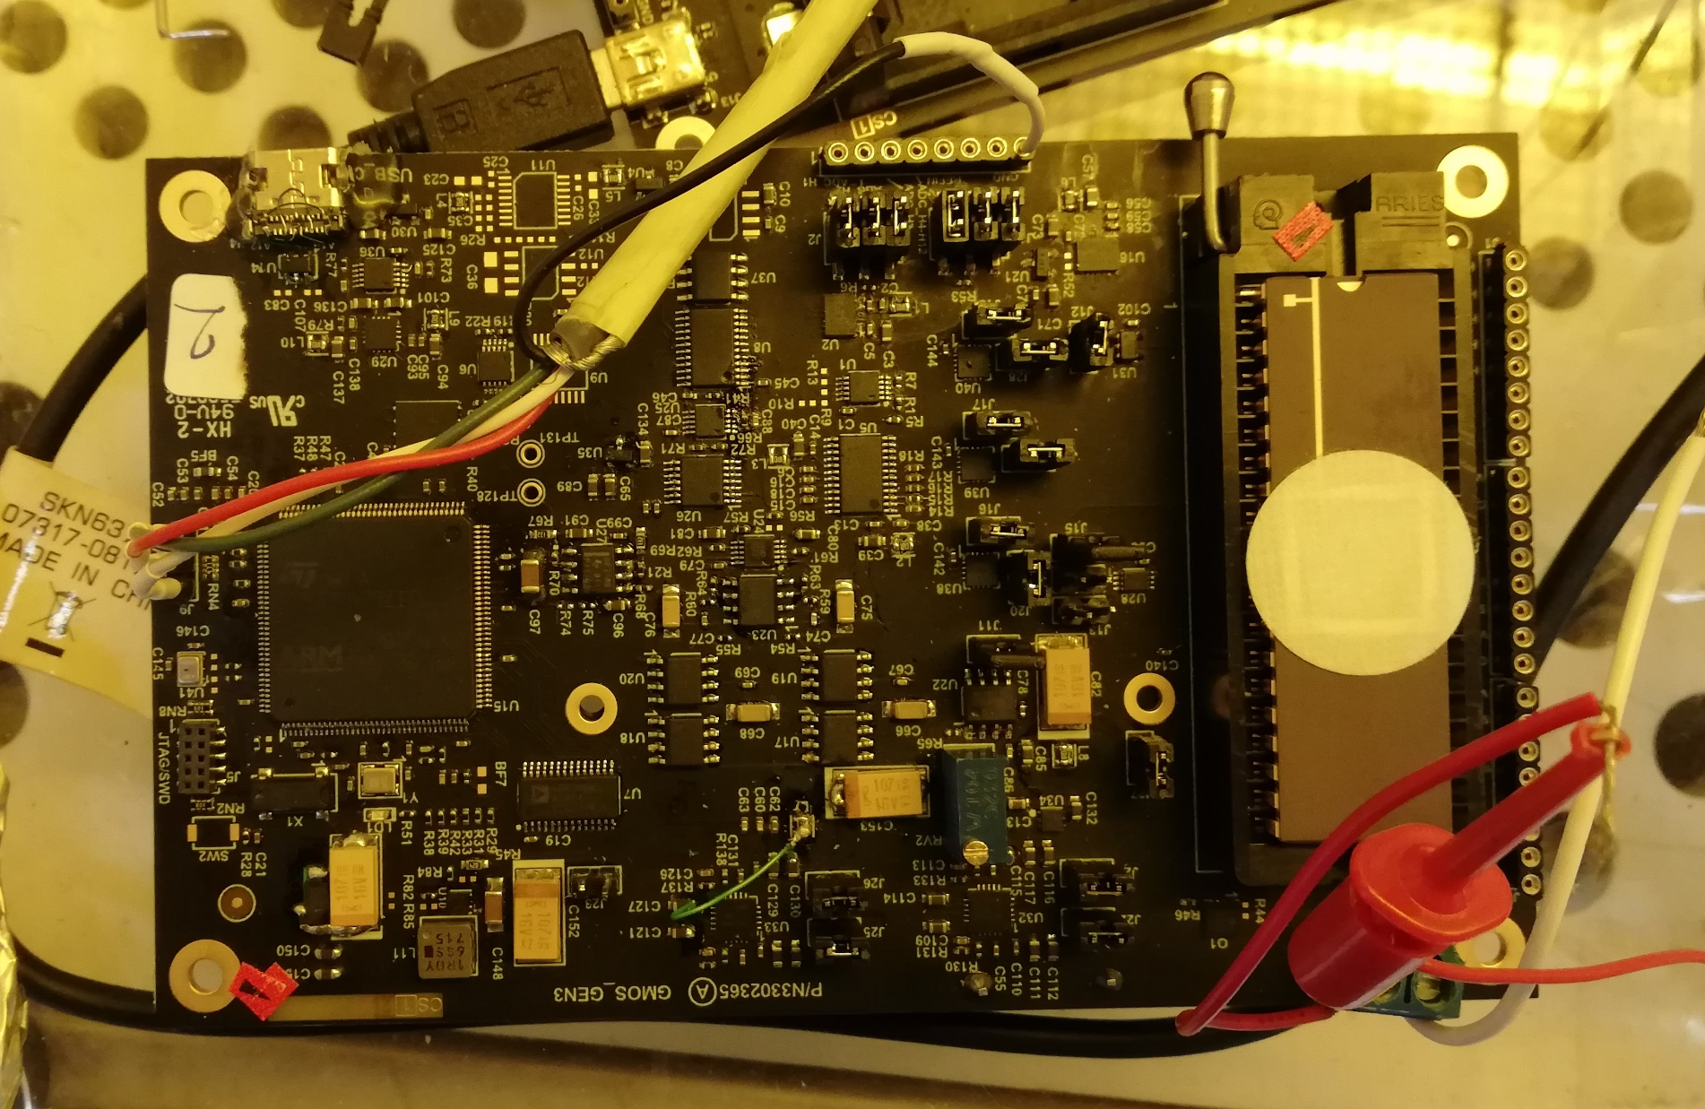
Evaluation Board
UART
GMOS Sensor
Power

Slide 4
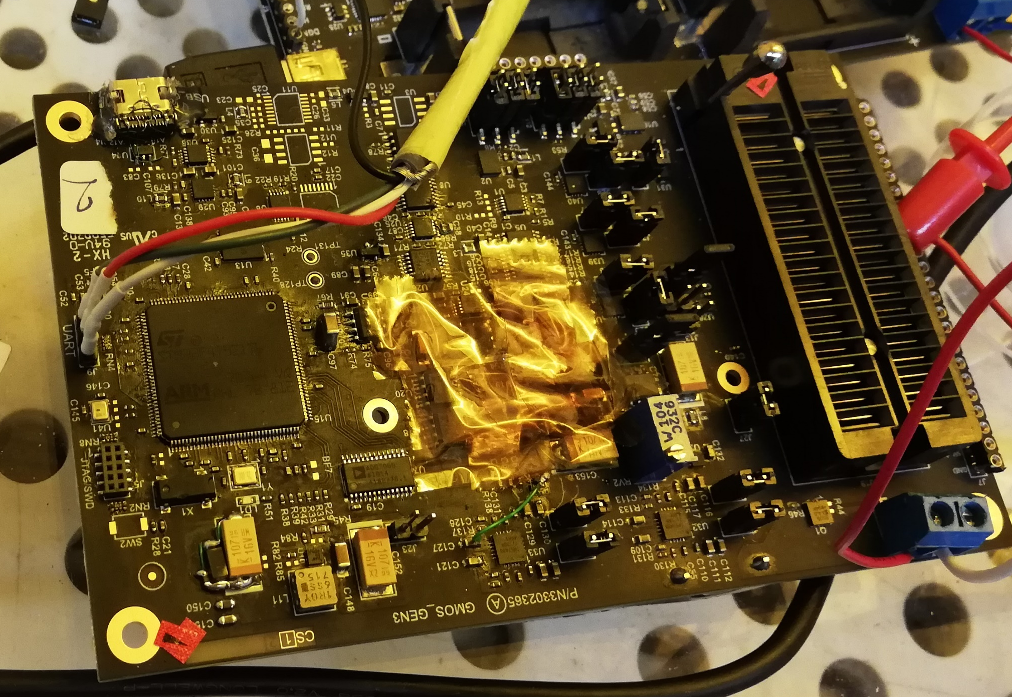
Standard Operating Procedure
Evaluation Board (EVB) Settings Check
  Connect UART Cable as shown in the picture below
GND – Black Cable
TX -> RX – Orange Cable
1
2
RX -> TX – Yellow Cable
3
  Apply voltage 6.2V with current compliance of 0.2A (from external voltage source) to power up the EVB
  Current In (I0) should be about 10uA – check the current on jumper J11
  Adjust if needed using potentiometer RV2

Slide 5
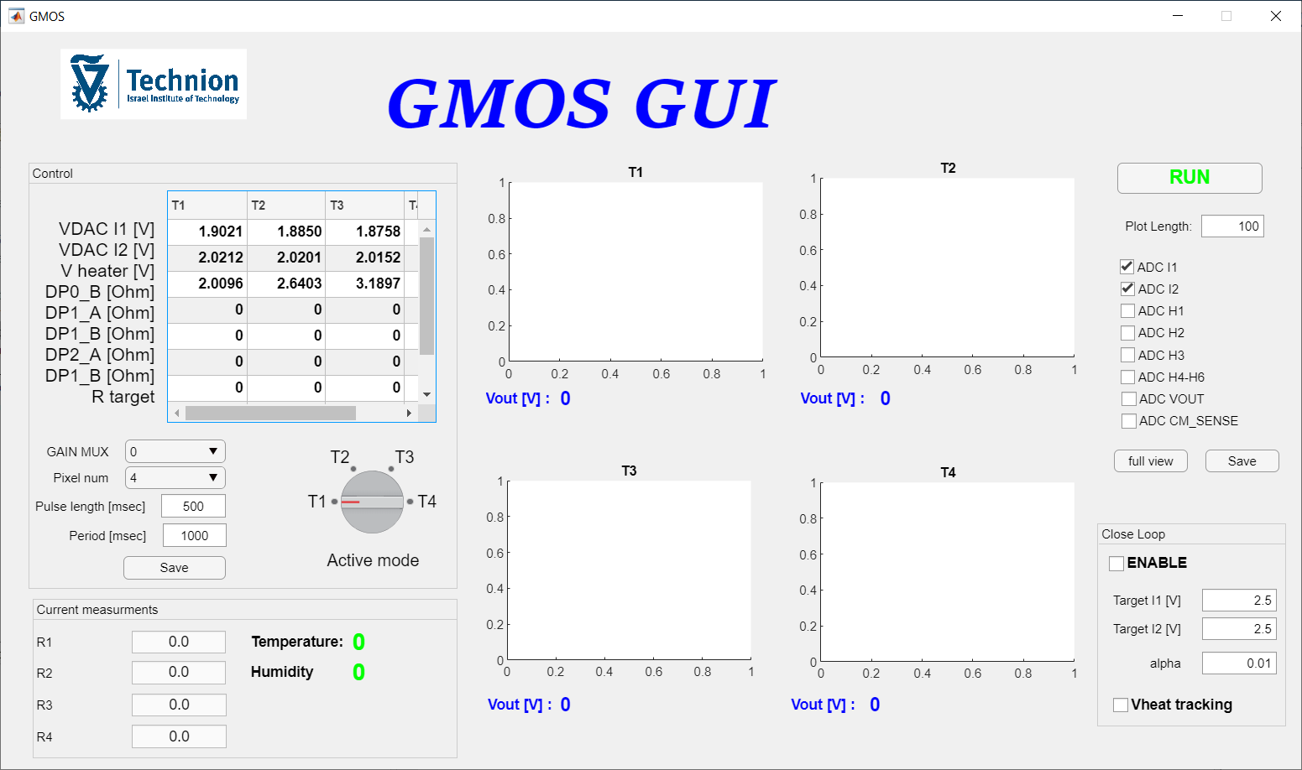

Standard Operating Procedure
Graphs
For 4 different
pixel temperatures
Operation With GMOS Software
  Window overview
Start
Measurement
Button
Graph
Control
Panel
Input
Panel
Blind & Active
Drain Voltage
Auto Setting
Heater
Temperature
Control

Slide 6
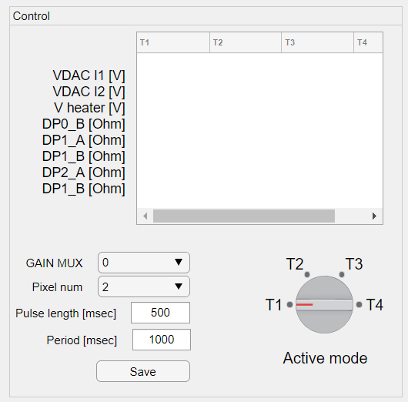
Standard Operating Procedure
Operation With GMOS Software
  Input Panel
Voltage applied to “Blind” current source
Voltage applied to “Active” current source
Heater voltage amplitude applied to heating resistor
Digital Potentiometers connected to Sources of GMOS sensor
GAIN Select
GAIN Table
Active pixel Select
GAIN MUX # | GAIN
0 | 1
1 | 10
2 | 100
3 | 1000
Pulse length and period
Saving the settings
Measuring Temperature
Switch

Slide 7
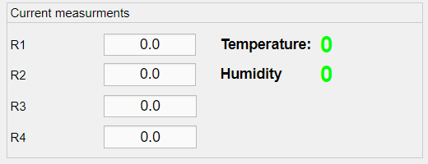
Standard Operating Procedure
Operation With GMOS Software
  Heater Temperature Control Panel
  Note: This panel is still in development
Input
NC
Resistance of heating resistor in Ohms
Blind
Active
Ambient Temperature
And Humidity
(From Temp/Humid sensor on EVB)

Slide 8
Standard Operating Procedure
Setting target drain voltage for Blind & Active pixels
Defining the updating rate (alpha)
Starting the algorithm by clicking on “ENABLE”
When the algorithm is working VDAC I1 and VDAC I2 are changing
Stop by unchecking the “ENABLE” box when the voltages are close to the target
Vheat tracking – enables temperature control by adjusting the R4 (Active) heating resistor value to a target value (R target)
Operation With GMOS Software
  Blind & Active Drain Voltage Auto Setting

Slide 9
Standard Operating Procedure
Current Vout value
Operation With GMOS Software
  Graph control
The visualization is in autoscaling mode – to change -> change the plot length
Visualization of the desired graph by checking the box
Saving the log file
Exiting from autoscaling mode
Activation of different temperatures plots by changing the Temperature switch

Slide 10
Standard Operating Procedure
Operation With GMOS Software
  Graph control
Blind & Active drain voltage graphs
Heater voltage graphs
VOUT graph
CM SENSE graph
IMPORTANT NOTE:
When switching between the temperatures during the tests, the previous temperature graph is freezing

Slide 11
Standard Operating Procedure
Performing the measurement with gas
  Close hermetically the gas chamber
  Power ON the EVB
  Start the software
  Select the Pixel and the Gain (default setting are Pixel 4, Gain x1, Heater frequency of 1 Hz with Duty cycle of 50%)
  Set the Active & Drain voltages using the software algorithm
  Start VOUT graph to obtain stable baseline
  IMPORTANT: Prior gas introduction start the operation of the fan inside the chamber (fan settings: V = 12V, I = 100 mA)
  Make sure that the GMOS sensor is with PTFE filter.
  Introduce the gas inside the chamber
  Stop the fan operation after a few seconds (if the gas introduced in a liquid form, wait until the drop is fully evaporated)
  Perform measurement
  Open the chamber to ventilate the gas chamber

